Slide 1
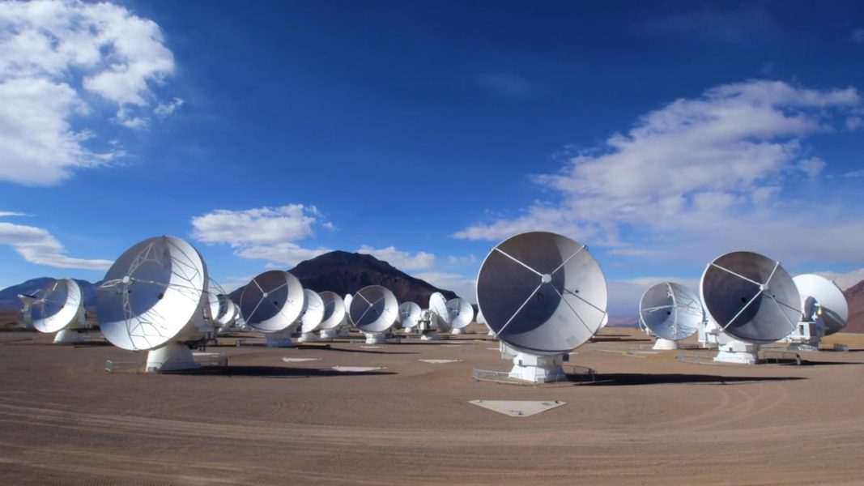


Dust Continuum Analysis of Distant Galaxies through Simulations of ALMA Observations
Sebastian Isaac Montaño
Dr. Allison Noble
Alex Pigarelli, Sarah Saavedra, Patrick Kamieneski
20 April, 2024
Image Credit: NRAO

Slide 2
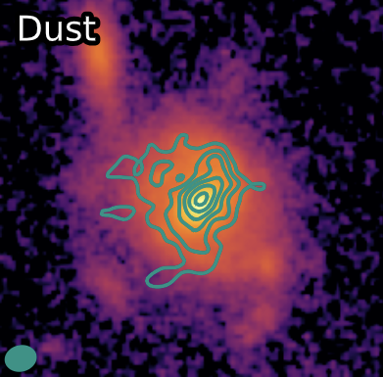
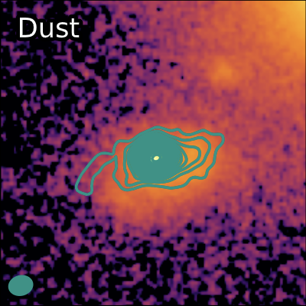
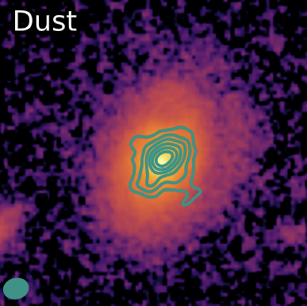
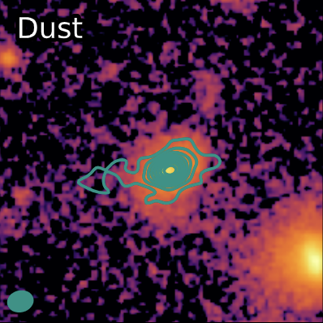
Agenda & Introduction
Understanding of Galactic Environments and Evolution
Thermal Dust Emission of Cluster Galaxies from 10 billion years ago
Pigarelli, 2023
Pigarelli, 2023
Generate ALMA simulations using our real observing conditions and measured galaxy properties
Determine the reliability of the measured properties over a grid of signal-to-noise ratios and sizes

Slide 3

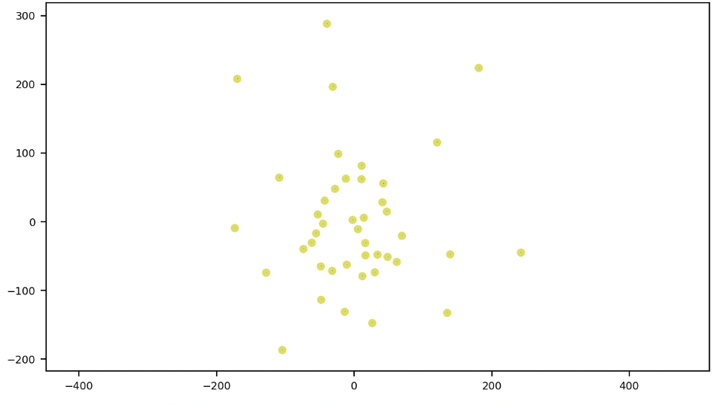
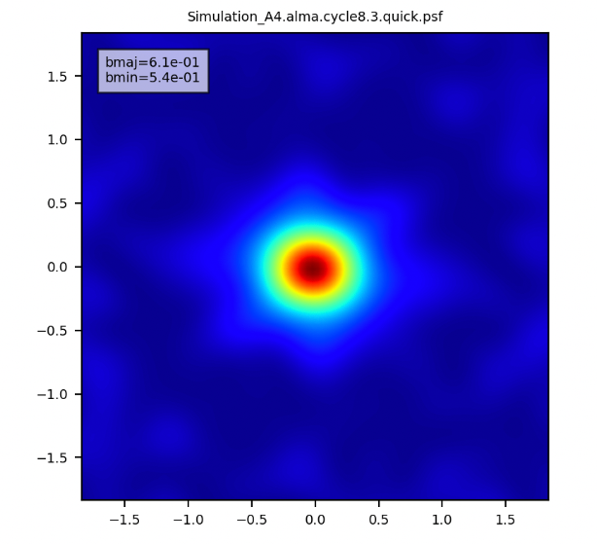
Simulation Procedure: Applications
Common Astronomy Software Application
Point Spread Function (PSF)
Antenna Configuration 8.3
Notes:
To include configuration of cycle 8.3 and delete CARTA

Slide 4
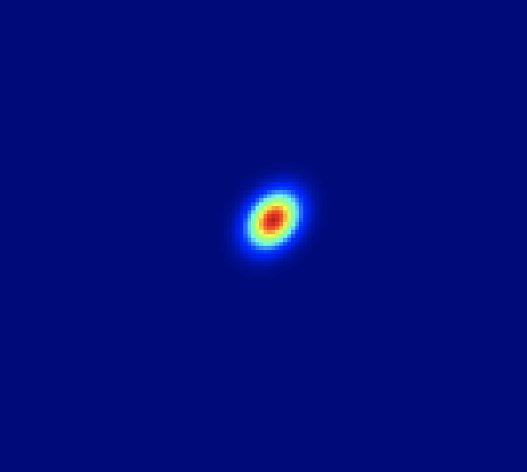
Simulation Procedure: Model Gaussian Distribution
Flux = 1.4 mJy
Major Axis = 0.500 arcsec
Minor Axis: 0.375 arcsec
Jy/beam

Slide 5
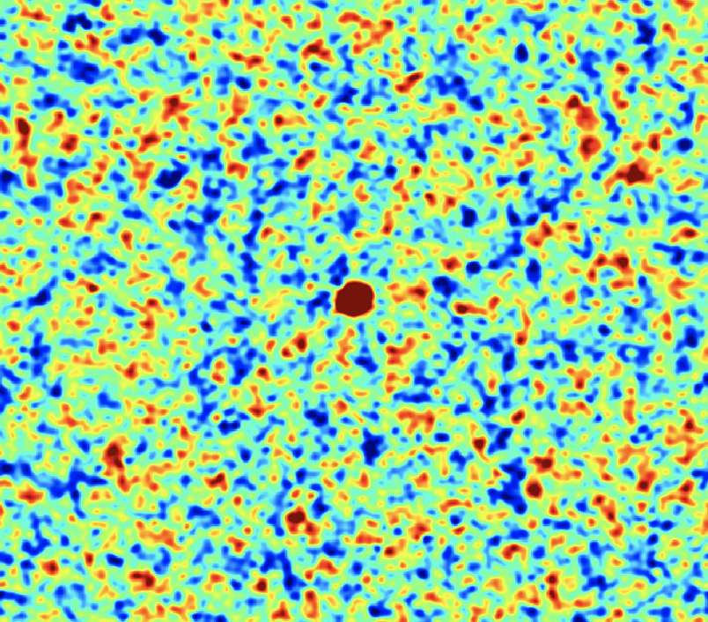
Simulation Procedure: Antenna Configuration
Model Gaussian Distribution
Point Spread Function for ALMA 8.3
Convolution of Model Gaussian with PSF & Noise

Slide 6
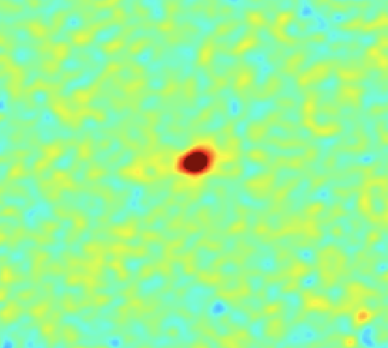
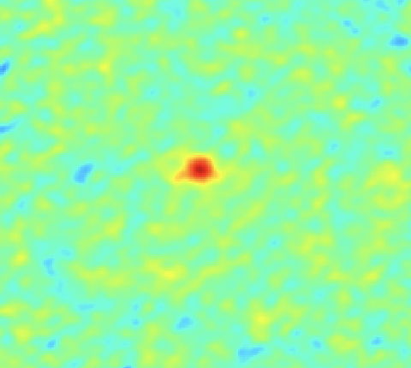
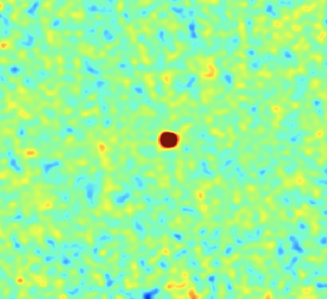
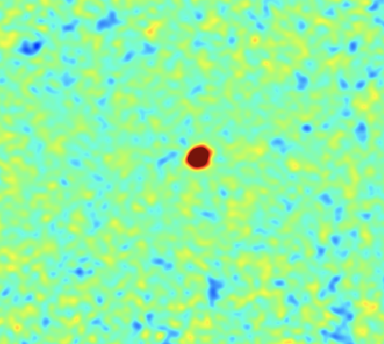
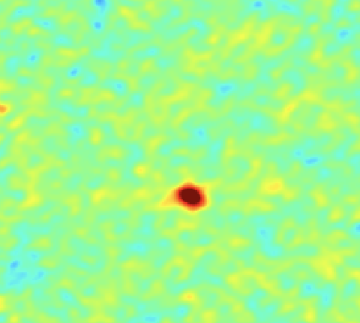
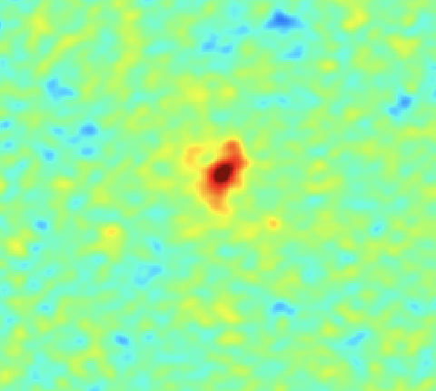
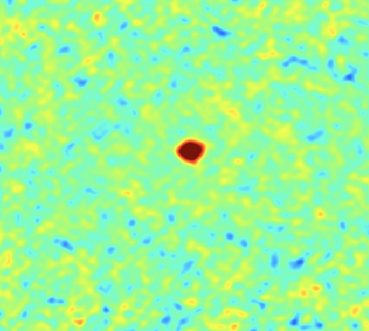
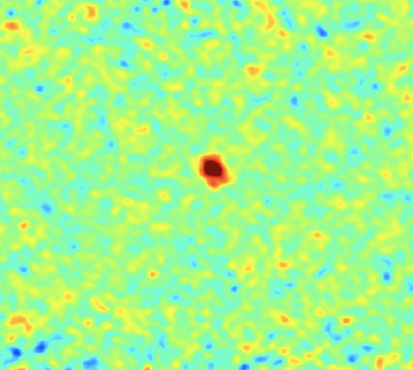
Simulation Procedure: Residual & Final Images (1)
?
Can you guess which of these two blocks are simulations?
Notes:
4 simulated with 4 actual images

Slide 7
Simulation Procedure: Residual & Final Images (2)
Real Sources
Simulations
J0224_191
J0224_104
Simulation A4
Simulation B5
J0224_366
J0224_104
Simulation C4
Simulation D3
Noble, Pigarelli 2023
Notes:
4 simulated with 4 actual images

Slide 8
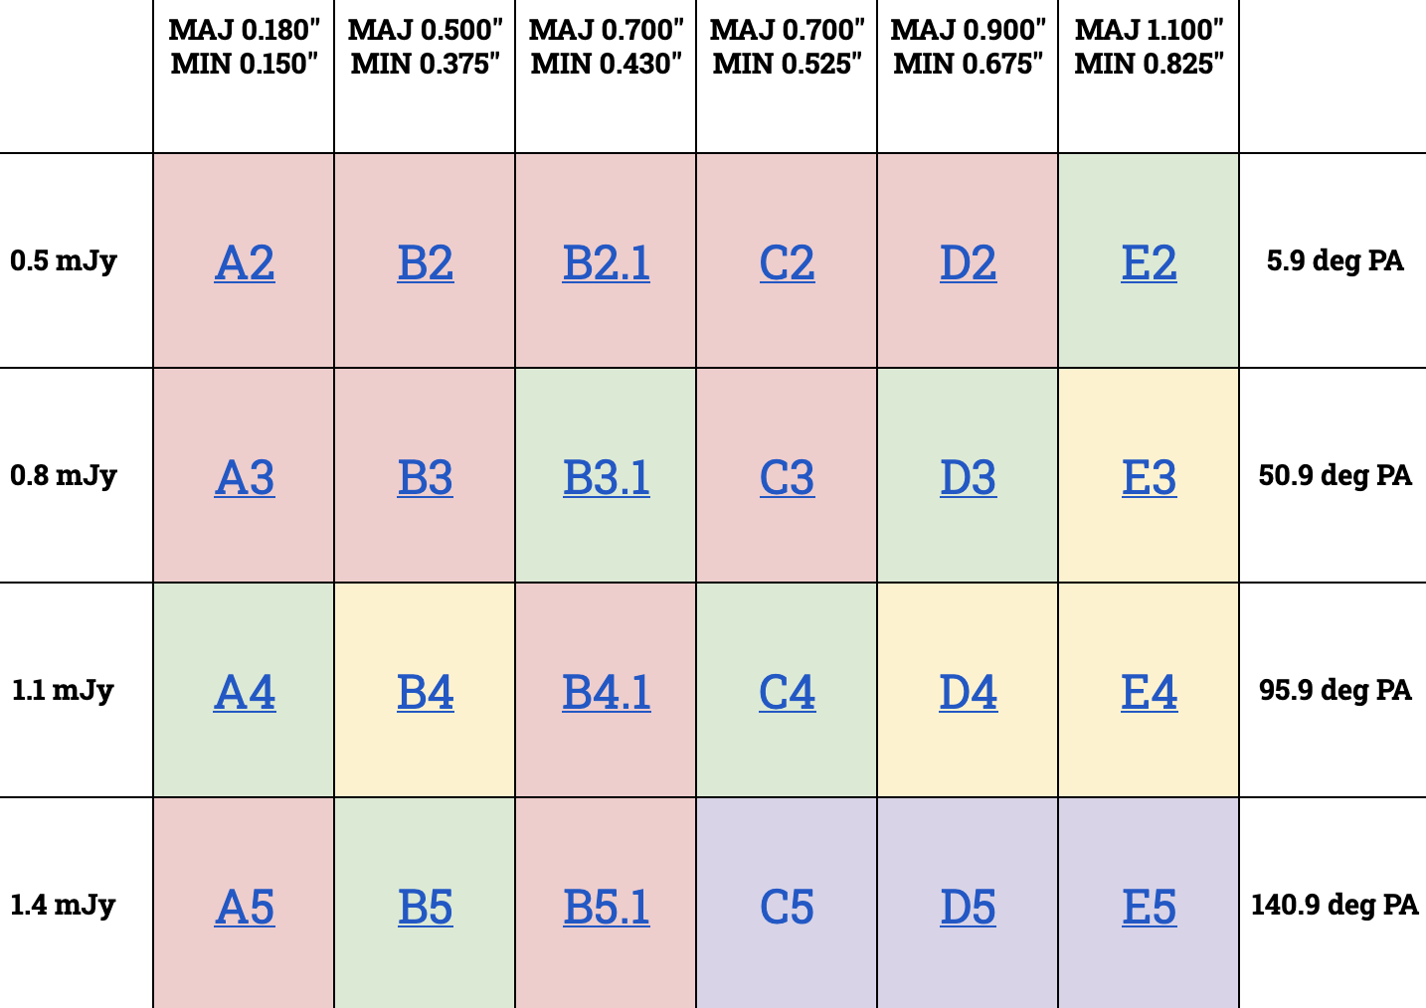

Parameter Space for Simulations
PA = Position Angle
MAJ = Major Axis
MIN = Minor Axis

Slide 9
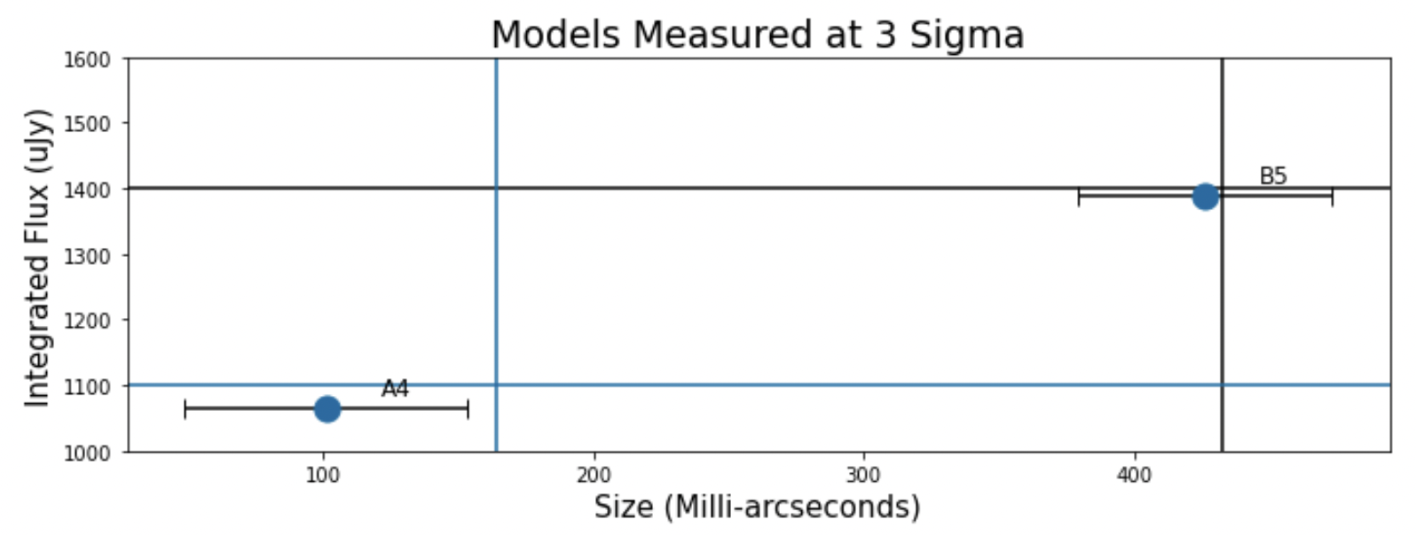
Initial Results and Future Work
Results thus far are within a relatively close range of the input parameters
Utilize this same methodology for each of the simulations over the full parameter space
Deduce any patterns of percentage errors among all the simulations
Saavedra, 2024

Slide 10
Thank You!

